Slide 1
Show, Attend and Tell: Neural Image Caption Generation with Visual Attention
Kelvin Xu Jimmy Lei Ba Ryan Kiros Kyunghyun Cho
University of Montreal University of Toronto University of Toronto University of Montreal
Aaron Courville Ruslan Salakhutdinov Richard S. Zemel Yoshua Bengio
University of Montreal University of Toronto University of Toronto University of Montreal
Ayush Patel
Kush Suryavanshi
Spandan Maaheshwari

Slide 2
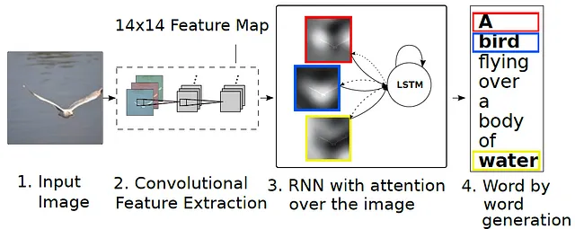
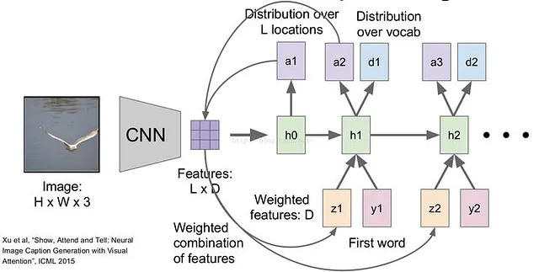

Model architecture
Notes:
High level architecture explanation

Slide 3
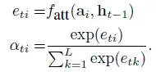
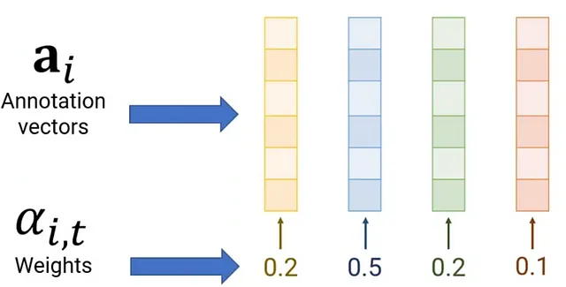
Context vector

Slide 4
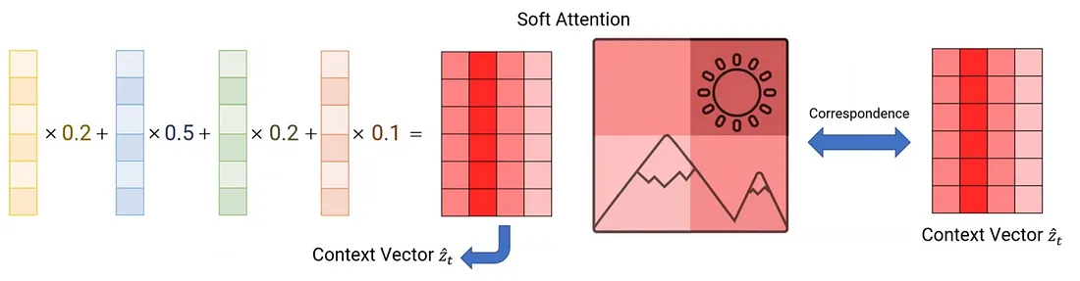
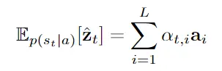
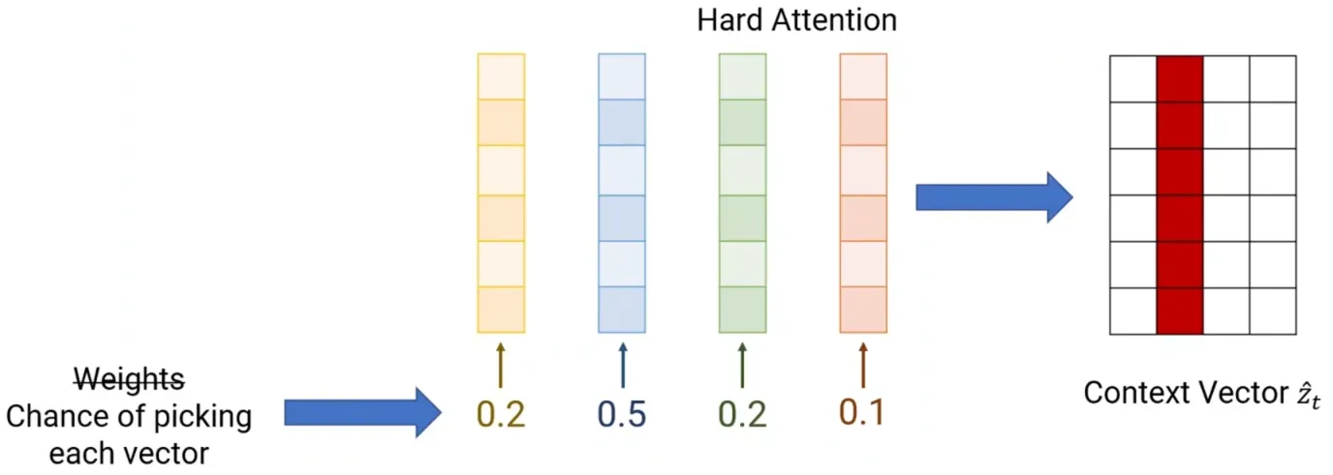
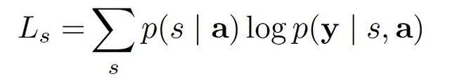
Attention mechanism
Notes:
Explanation of attention mechanism

Slide 5
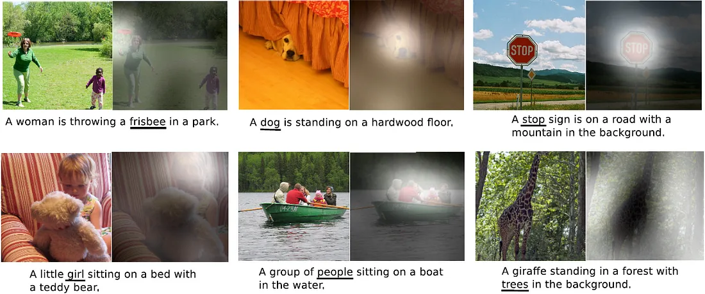
Experimentation Results

Slide 6
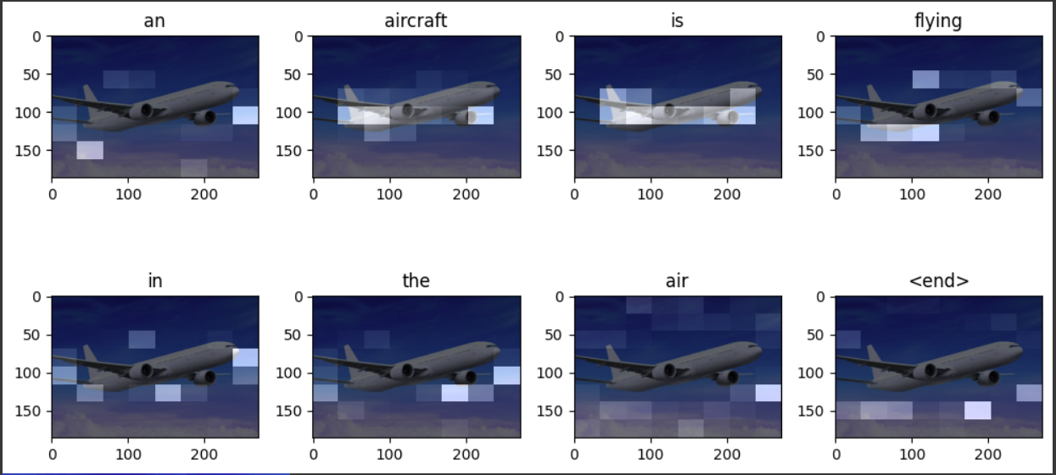
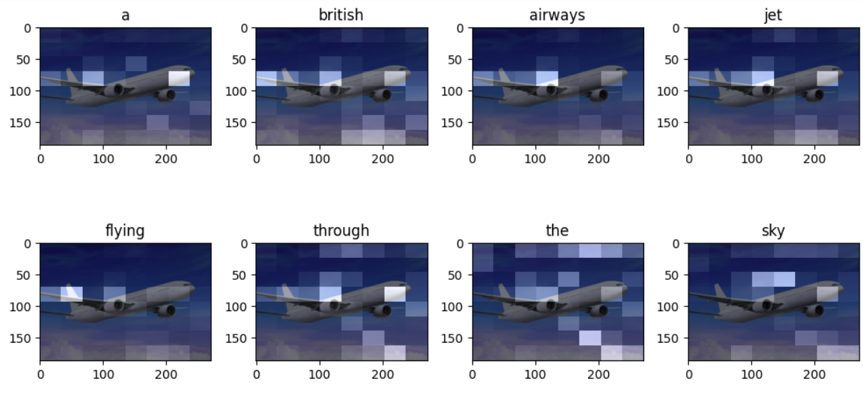
Implementation Results
Inception V3
VGG19

Slide 7

Original Image

Slide 8
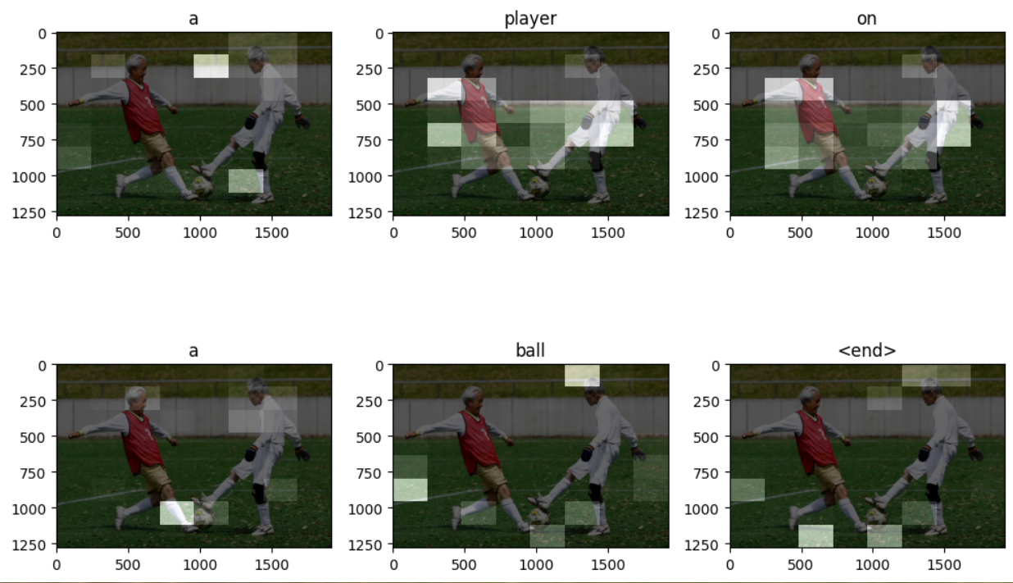
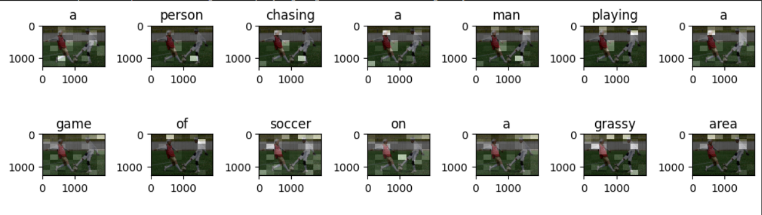
Implementation Results
Inception V3
VGG19

Slide 9
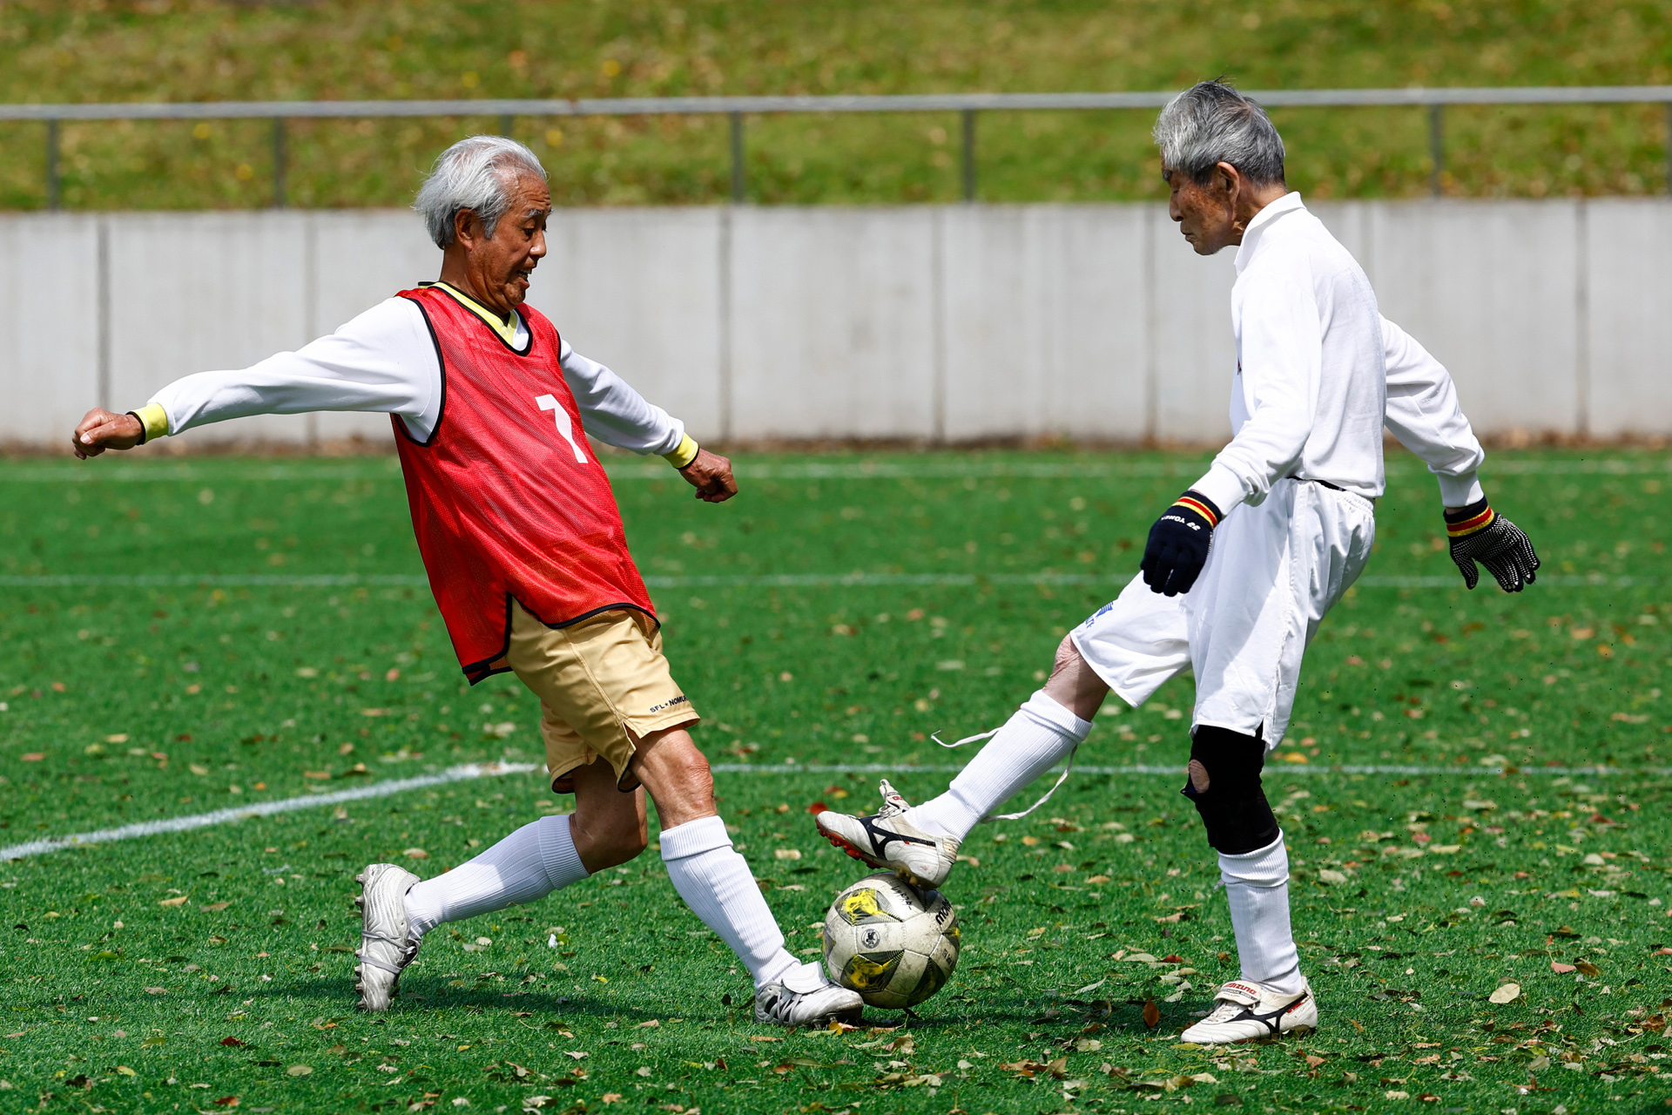
Original Image

Slide 10
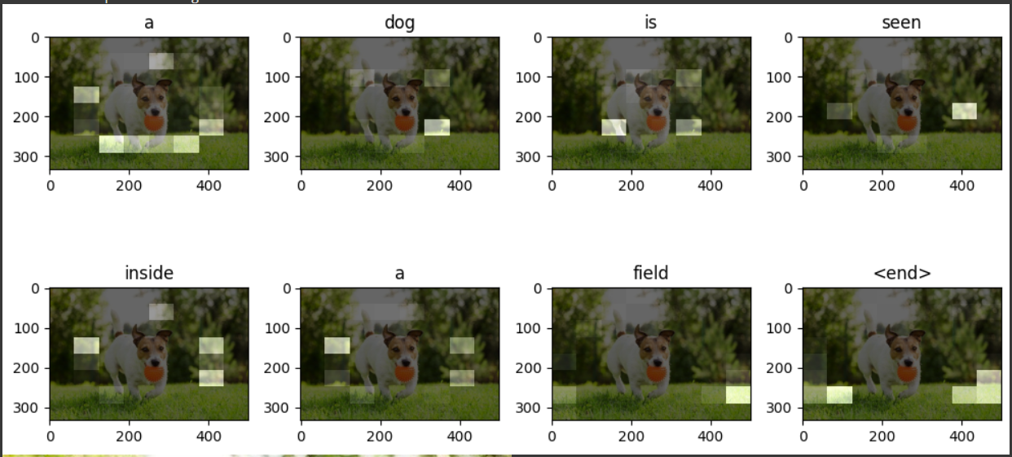
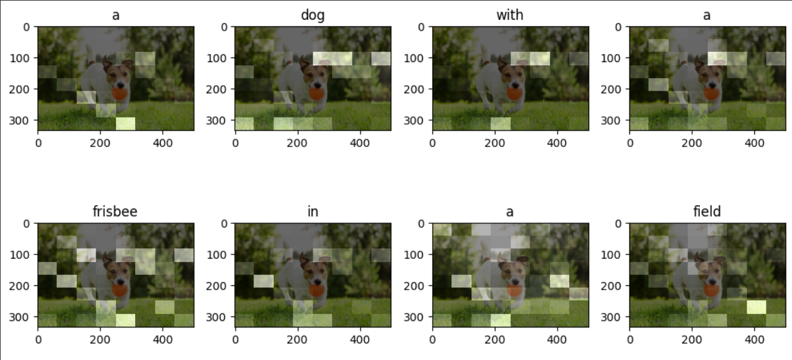
Implementation Results
Inception V3
VGG19

Slide 11
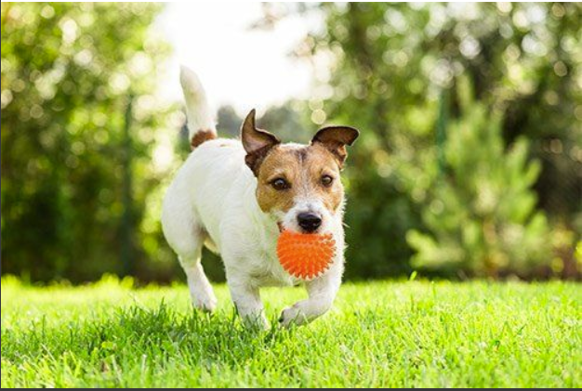
Original Image

Slide 12
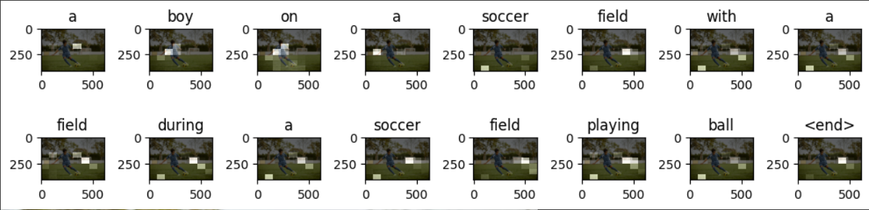
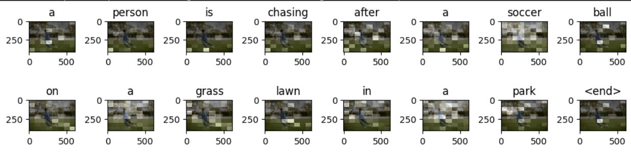
Implementation Results

Slide 13

Original Image

Slide 14
Metric Comparison
 | BLUE-1 | BLUE-2 | BLUE-3 | BLUE-4 | METEOR
Paper | 70.7 | 49.2 | 34.4 | 24.3 | 23.9
Inception V3 | 36.00 | 12.42 | 6.20 | 3.17 | 10.04

